Slide 1
Engaging Communities and Publics
Week 6 - 10.3.2019

Slide 2
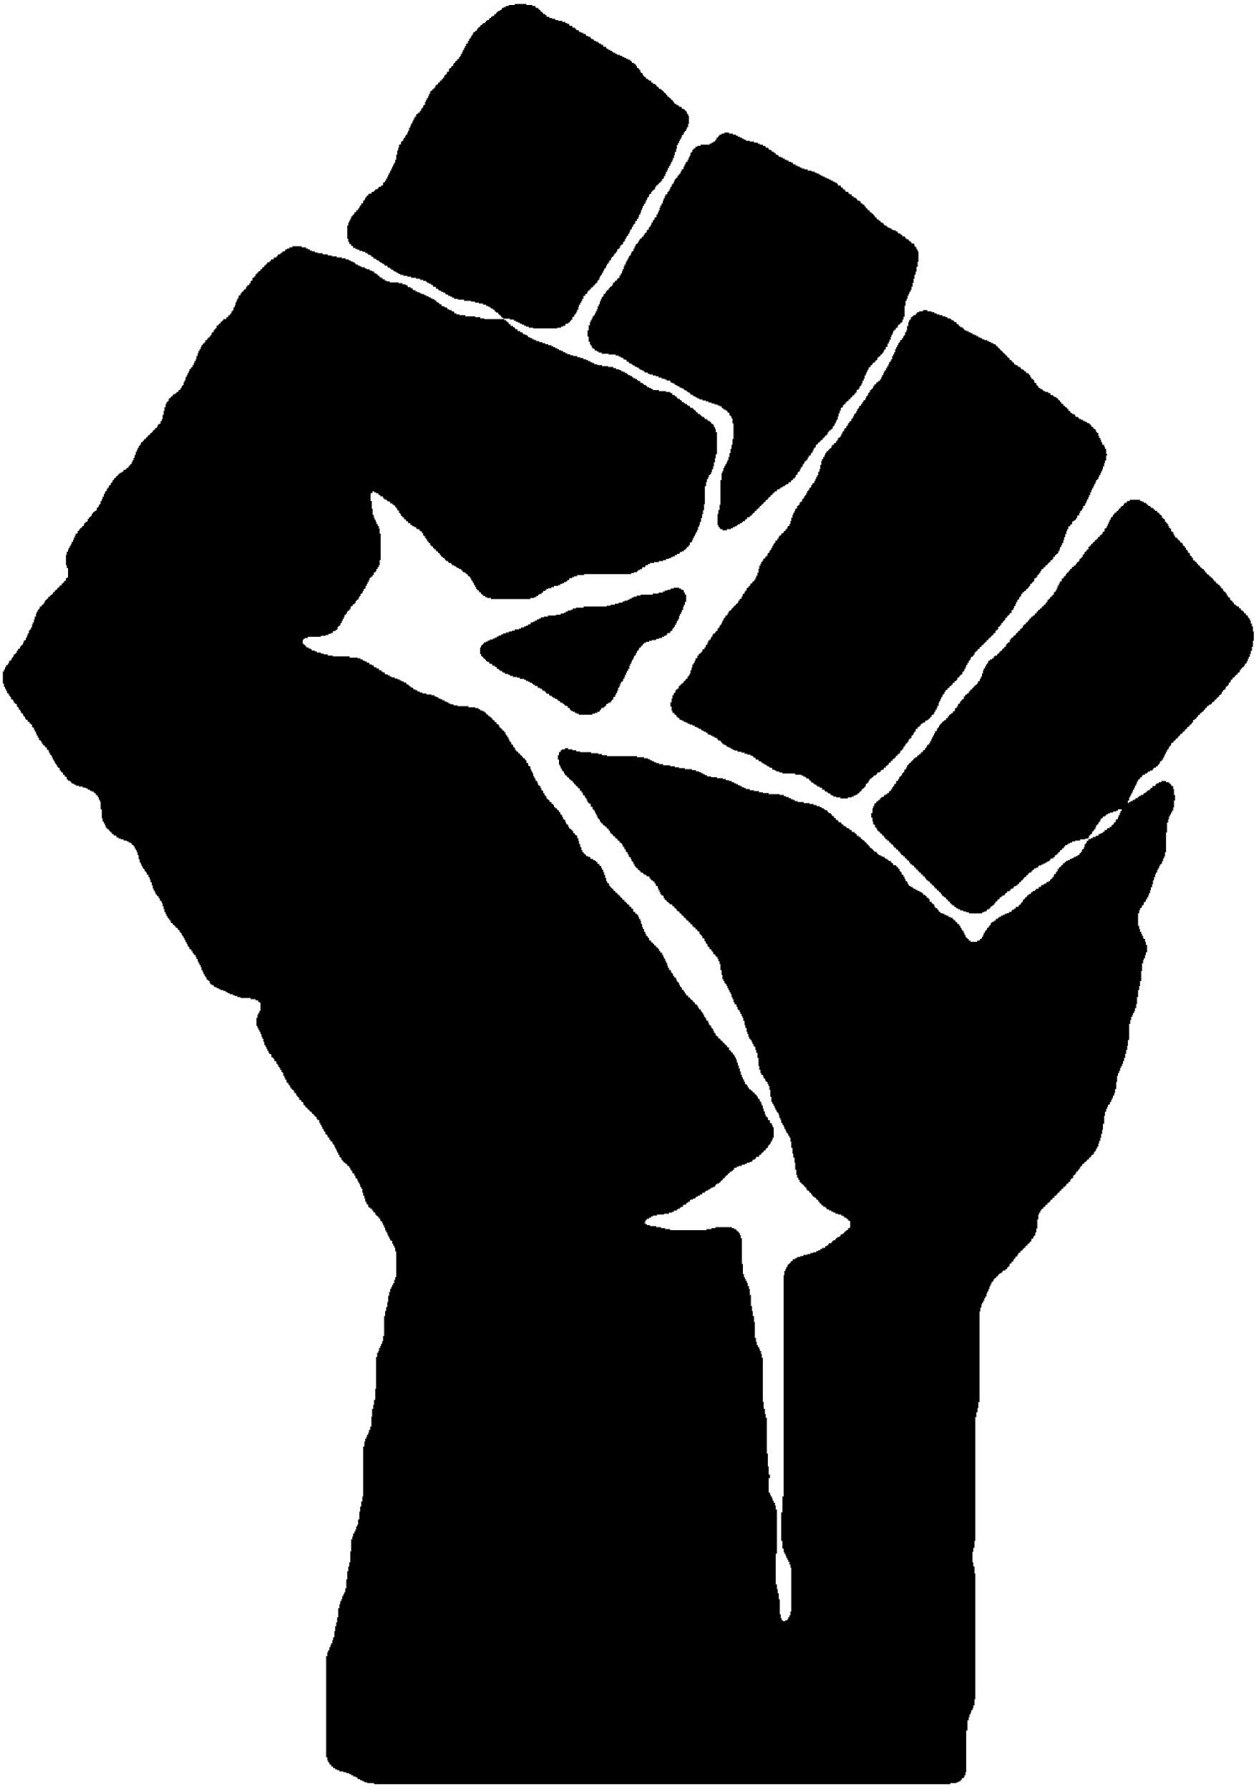
Opening Reflection
4:30-4:35
On the whiteboard
What words capture the relationships you desire to build with “communities” and “publics” beyond ENGAGEMENT

Slide 3
Working Groups
4:35-5:35
“Final” touches on syllabus, lesson plan, and plan for podcast
What kind of support (technical or otherwise) do you need for your lesson plans and to document our class sessions?

Slide 4
Orientations
5:45-7:00
How do we understand the public(s) and communities imagined in public and community engagement? What are the implications of the multiple and contested meanings of these frameworks?
What are the risks and responsibilities of forms of public and community engagement, particularly those that endeavor to critique or transform power structures?
What can we learn from models of engagement with communities that are participatory, desire-centered, or anti-oppressive in purpose and practice?

Slide 5
Re/imagining engagement, communities, publics
Academic Freedom in the Digital Age
Readings
Penn and Philadelphia Communities
Modeling Community and Public Engagement
Penn and Slavery

Slide 6
Suspending Damage: A Letter to Communities
Critical participatory action research as public science
Publics and Counterpublics
Re/imagining engagement, communities, publics

Slide 7
“Here I am concerned with research [...] that invites oppressed peoples to speak but to ‘only speak from that space in the margin that is a sign of deprivation, a wound, an unfulfilled longing. Only speak from your pain’ (hooks, 1990, p. 152). [...] Common sense tells us this I a good thing, but the danger of damage-centered research is that it is a pathologizing approach in which the oppression singularly defines a community” (413)
“One alternative to damage-centered research is to craft our research to capture desire instead of damage. [...] desire-based research frameworks are concerned with understanding complexity, contradiction, and the self-determination of lived lives. [...] This is to say that even when communities are broken and conquered, they are so much more than that--so much more that this incomplete story is an act of oppression (416)
Eve Tuck. (2009). “Suspending Damage: A Letter to Communities.”

Slide 8
“Joining social movements and public science, critical PAR [critical participatory action research] projects document the grossly unequal structural distributions of opportunities, resources, and dignity; trouble ideological categories projected onto communities (delinquent, at risk, damaged, innocent, victim); and contest how “science” has been recruited to legitimate dominant policies and practices” (171)
“There is no single way to conduct critical PAR. Rather, we believe critical participatory researchers are bound by a set of critical and participatory commitments throughout the research process, such as finding ways to harness varying forms of expertise; constructing what questions most need asking; collaborating to develop both theory and method; coanalyzing data; and creating ongoing and multiple forms of dissemination with a principled purpose of working against unjust, oppressive structures” (175). KS
M.E. Torre et al. (2012). Critical participatory action research as public science

Slide 9
“The way the public functions in the public sphere--as the people--is only possible because it is really a public of discourse. It is self-creating and self-organized, and herein lies its power as well as its elusive strangeness.”
“Nancy Fraser observed that when public discourse is understood only as a ‘single, comprehensive, overarching public,’ members of subordinated groups ‘have no arenas for deliberation among themselves about their needs, objectives, and strategies.’ In fact, Fraser writes, ‘members of subor-dinated social groups—women, workers, peoples of color, and gays and lesbians—have repeatedly found it advantageous to constitute alternative publics.’ She calls these “subaltern counterpublics,” by which she means “parallel discursive arenas where members of subordinated social groups invent and circulate counterdiscourses to formulate oppositional interpretations of their identities, interests, and needs” (85)
Michael Warner. (2002). “Publics and Counterpublics”

Slide 10
Talking out of School: Academic Freedom and Extramural Speech
The Criminalization of Knowledge
My Life as a Cautionary Tale: Probing the Limits of academic freedom
Academic Freedom in the Digital Age

Slide 11
“When I make a public comment, I don’t care if it conforms to the etiquette of a speech manual. I’m instead concerned with the needs and aspirations of the dispossessed. Conditioning critique on the conventions of bourgeois civil liberties, and in deference to specters of recrimination, abrogates any meaningful notion of political independence. To ignore those conventions, to engage the world based on a set of fugitive values, will necessarily frustrate those in power in ways that require protection beyond the scope of academic freedom.” KS
“I was a tenured faculty member for 12 years and count myself among the complicit. I didn’t do nearly enough to support my contingent comrades — because I didn’t properly see them as comrades, something my position informally demanded. We all know, in personal moments of brutal honesty, that radical devotion to lesser classes is almost always just professional branding — that deep down we’re scared of the punishment that awaits if we offend the wrong people.
Academic freedom doesn’t take away the fear because we know that management can always find ways around it.” KS
Steven Salaita. 2019. “My Life as a Cautionary Tale: Probing the Limits of academic freedom.”

Slide 12
“Since scholars are also citizens, academic freedom includes the provision that academics are entitled, like all citizens, to engage in political expression. When extramural expression takes the form of political dissent against authoritarian regimes, the university has an obligation not to let the state inside the door of the university to quell that speech.”
“Although academic freedom and freedom of political expression are not the same, punishing academics for their real or imagined political power tells us something about the role of universities within democratic life. Universities produce ideas that have a life of their own; the free circulation of those ideas is part of democratic political culture, and the protection of that circulation is an obligation of democratic societies.”
Judith Butler. 2018. “The Criminalization of Knowledge.”

Slide 13
“Now is the time to insist that the extramural speech of university professors is vitally important to the functioning of a free society, especially when it involves academic expertise in things like climate change, colonialism, race relations, gender and sexuality, ethnocentrism, poverty, medicine, technology, urban planning, ecology . . . and, among many other things, theories of justice. Now is the time to insist that extramural speech is a vital aspect of academic freedom—precisely because the struggle for academic freedom is the struggle for democracy.” KS
--Note from KS: Part of Bérubé’s argument is a disagreement with Butler’s claim (see next entry) that academic freedom and freedom of political expressions are separate. He thinks freedom of political expression should be an aspect of academic freedom, though they both agree that it should be protected.
Michael Bérubé. 2019. Talking out of School: Academic Freedom and Extramural Speech.

Slide 14
Penn and Philadelphia Communities
Penn Disorientation Guide
ABC Penn and Community Partnerships Working Group

Slide 15
Penn and Slavery
We Challenged Penn to Reexamine Its History of Slavery—And Our Project Isn't Over.
As reparations debate continues, the University of Pennsylvania has a role to play

Slide 16
“The early trustees of the University of Pennsylvania helped design symbols of American freedom while keeping other men in bondage.”
“This research is not supposed to start a competition to see which institution has the fewest ties to the American slave trade. This is not an attack on Penn’s reputation. This is a search for the truth. The desire for reassurance that one institution’s history is less problematic than another speaks to a reluctance to engage in a genuine discussion about slavery.”
Vanjessica Gladney. Feb. 28 2018. “We Challenged Penn to Reexamine Its History of Slavery—And Our Project Isn't Over.”

Slide 17
“In response to the Penn & Slavery Project’s work, the university reversed its stance asserting it had no historical ties to slavery and announced it would form a working group to explore the issue further. Still, it is disturbing that bodily remains of enslaved people are warehoused at a school, to highlight the discredited science of a former professor in the name of historical preservation. I was appalled when learning about this during both a symposium on the Penn & Slavery Project and the spring final presentations of student researchers in April. I launched a change.org petition demanding the university return the remains to descendants — if possible — or inter them immediately.”
“Black people deserve reparations from institutions that benefited from the violence of the enslavement we experienced for generations. Penn is among the guilty. It also arguably continues to harm local black communities in West Philadelphia by driving residential displacement through university expansion. At the very least Penn can disavow Morton, and bury our ancestors.”
Abul-Aliy Muhammad. July 21 2019. “As reparations debate continues, the University of Pennsylvania has a role to play.”

Slide 18
Bronx Community Research Review Board
Soundwalk of Northside Histories of Home: A Walk With Northside Neighbors
Morris Justice Project
This Ain’t a Eulogy: A Ritual for Re-Membering
Community Futures Lab
Torn Apart/Separados Mapping Project
Modeling Community and Public Engagement

Slide 19
“In order to protect the disadvantaged and vulnerable populations in the Bronx from academic research abuse, such as lying about the potential dangers of studies or violating their human rights, a group of passionate community members established The Bronx Community Research Review Board (BxCRRB). We are advocates for the Bronx, working to create a better life for everyone in our community.”
“No Research About Us Without Us: BxCRRB was founded in 2008 as a way to add community-focused oversight to the research review process. Drawing from the expertise and knowledge of these organizations, BxCRRB was able to form a volunteer board that could learn about the processes and best practices of an academic research study. By combining this training with genuine understanding and familiarity of the unique needs and nuances of Bronx residents, BxCRRB has been able to educate researchers on what is ethically and culturally beneficial to our community.”
Bronx Community Research Review Board

Slide 20
“Histories of Home is an invitation to listen to everyday history-makers. Featuring the voices of over a dozen community members and narrated by Northside natives, this audio tour is an introduction to some of the stories, struggles, and aspirations of our community.”
“The Value of Oral History: Oral history is at the center of the Jackson Center’s organizing model. It teaches us values, visions, struggles, and victories of every day history-makers, and it has continued to ground our work in listening and to inspire all of us to build a more just community together.
Our primary aim is to listen well: to hear and to carry forward histories shaped by abiding values and visions for vibrant community. We want to make sure that the histories of everyday, courageous and faithful leadership that we are privileged to hear—and to hold in the Jackson Center Oral History Trust—make a difference in our communities now and for generations to come.
The Marian Cheek Jackson Center: Soundwalk of Northside
Histories of Home: A Walk With Northside Neighbors

Slide 21
“Morris Justice is a Participatory Action Research (PAR) Project. PAR is an approach to research rooted in the belief that valid knowledge is produced only in collaboration and in action, and that those typically “studied” should be architects of the process. Morris Justice is guided by the critical social knowledge of residents of a NYC "hot spot," a neighborhood that is subjected to a disproportionate amount of aggressive and discriminatory policing in the name of "community safety." It is an in-depth investigation into the lived experience of NYPD's "hot spot" policy and "stop and frisk" practices, and the community's vision of community safety.”
“Sidewalk Science: Throughout the summer of 2013 we did "Sidewalk Science" around the MJP neighborhood, creating opportunities to discuss and continue our research with residents. We did critical mapping, made and distributed data t-shirts and buttons, constructed Community Safety Walls, handed out our back-pocket report, and talked to people about the implications of the Community Safety Act and Floyd Trial. See more here.”
Morris Justice Project (Bronx, New York)

Slide 22
“Based on Taja Lindley's solo healing performance ritual that debuted at La Mama's SQUIRTS in 2015, "This Ain't A Eulogy" is drawing parallels between discarded materials and the violent treatment of Black people in the United States. People in the African Diaspora have a long history of repurposing, remixing, and transforming oppressive systems into valuable cultural practices. In this post-Ferguson moment, Lindley is calling on this legacy to imagine how we can recycle the energy of protest, rage, and grief into creating a world where, indeed, Black Lives Matter.
"This Ain't A Eulogy" is the origin story of The Bag Lady, and serves as a preamble to Lindley's one woman show "The Bag Lady Manifesta" which debuted at Dixon Place September 2017. TajaLindley.com”
Taja Lindley: The Bag Lady Manifesta.
“This Ain’t a Eulogy: A Ritual for Re-Membering.”

Slide 23
Community Futurisms: Time & Memory in North Philly* is a collaborative art and ethnographic research project exploring the impact of redevelopment, gentrification, and displacement in North Philadelphia through the themes of oral histories, memories, alternative temporalities, and futures. From May 2016-May 2017, BQF Collective operated Community Futures Lab at 2204 Ridge Avenue, which functioned as a gallery, resource and zine library, workshop space, recording booth, and time capsule, recording oral histories/futures in the North Philly neighborhood of Sharswood.
Rasheeda Phillips: Community Futures Lab

Slide 24
“Volume 2 of Torn Apart is a deep and radically new look at the territory and infrastructure of ICE’s financial regime in the USA. This data & visualization intervention peels back layers of culpability behind the humanitarian crisis of 2018.”
“As we have gathered and curated this data and produced these visualizations, we share certain underlying assumptions: the express knowledge that data is imprecise, impure, and as much a tool for incarceration and control as it is for revealing the truth; that maps, which have become of primary importance to our daily life, are themselves highly contingent fabrications, bending the physical reality of the world to our innate need to grasp and process, and dangerously full of altered data.”
Torn Apart/Separados Mapping Project

