Slide 1
Freedom Dreams: Activism and Radical Traditions
Week 3 - 9.12.2019

Slide 2
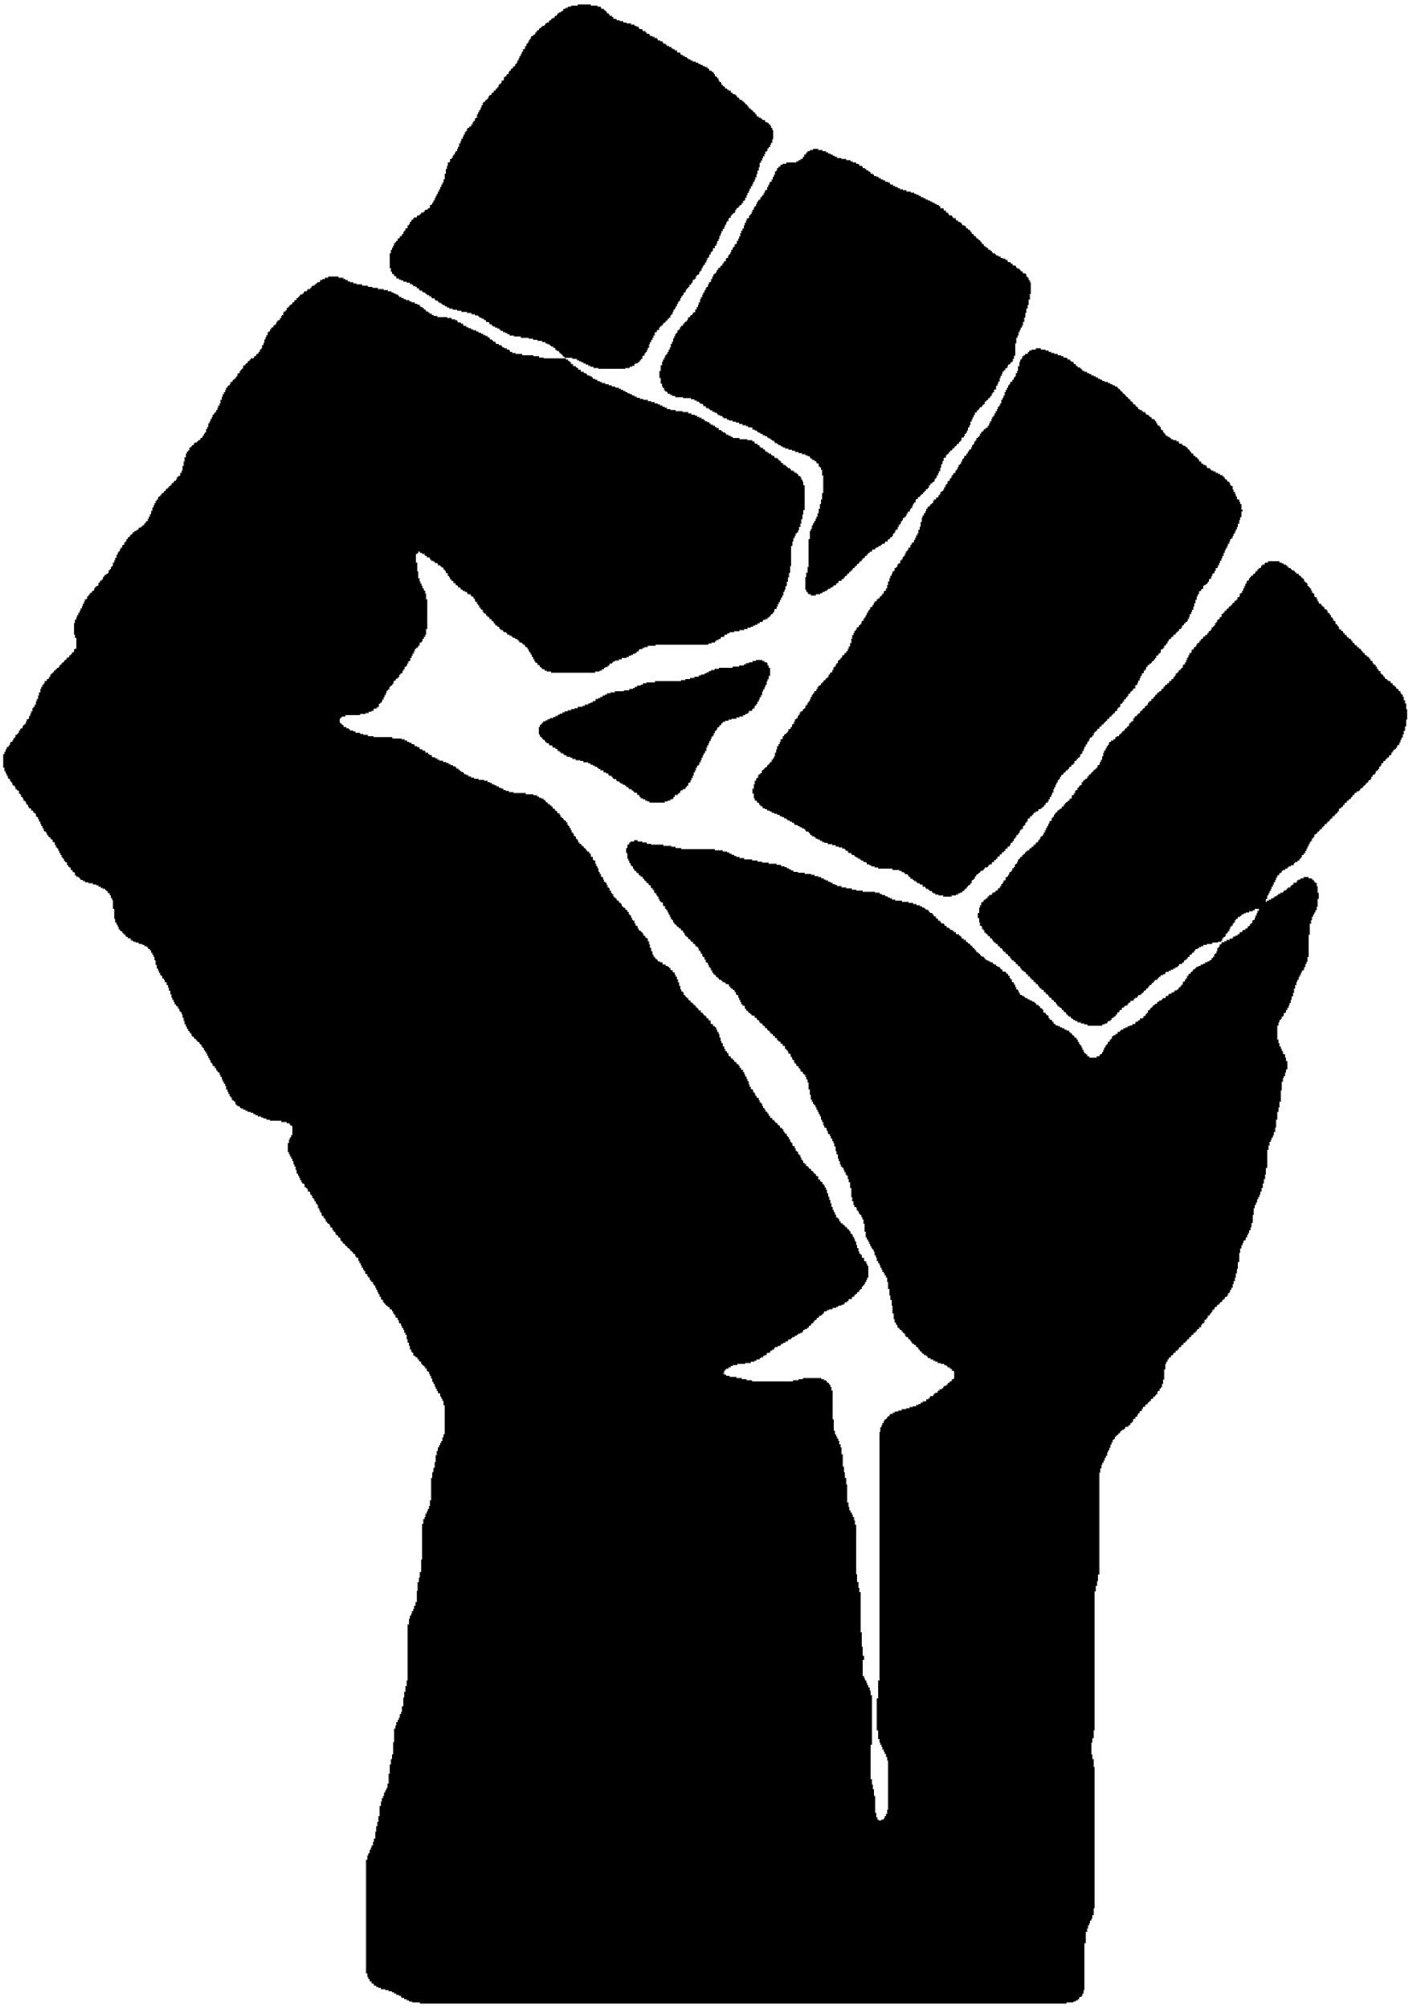
Opening Reflection
4:30-4:45
Get Up. Stand Up
Think of a time when you stood up for your rights or the rights of others. What were the conditions of this moment? Why then? How did this experience make you feel in the moment? What kind of memories have you retained of this experience in the present?
On the whiteboard:
Of all the ways of conceiving political action and the formation of radical identities, which resonate most to you personally in this moment (i.e. leader; activist, human, radical)? Why?

Slide 3
Orientations
4:45-5:45
What is activism and how else might we theorize political action?
What kinds of freedom dreams and horizons of political possibility do these approaches open up or foreclose?
What are the spaces of connection and tensions among these ways of conceiving political action?
What are the affordances and limits of theorizing political action in these ways at this particular time and in response to specific social problems?
Do these ways of theorizing political action presume particular kinds of subjects or political projects? If so, how?

Slide 4
Readings
Paradigms of
Political Action
Manifestos of/for the Moment
Movement
Cultures

Slide 5
The Transformation of Silence into Language and Action.
Ella Baker and the Origins of ‘Participatory Democracy
Community Organizing or Organizing Community?
Against Activism
Decolonization is Not a Metaphor
Paradigms of
Political Action

Slide 6
“What are the words you do not yet have? What do you need to say? What are the tyrannies you swallow day by day and attempt to make your own, until you will sicken and die of them, still in silence” (41)
“We can learn to work and speak when we are afraid in the same way we have learned to work and speak when we are tired. For we have been socialized to respect fear more than our own needs for language and definition, and while we wait in silence for the final luxury of fearlessness, the weight of that silence will choke us” (44)
Audre Lorde (1984) “The Transformation of Silence into Language and Action.”

Slide 7
“On what basis do you seek to organize people? Do you start to try to organize them on the fact of what you think, or what they are first interested in? You start where the people are. Identification with people.” (p. 84)
“The three themes of participatory democracy--grassroots involvement by people in the decisions that affect their lives; the minimization of hierarchy and professionalization in organizations working for social change; and direct action on the sources of injustice--grew out of more than twenty years of political experience that she brought to the fledgling student movement in the spring of 1960.” (p. 82)
“Strong people don’t need strong leaders” (Ella Baker quoted on p. 70)
Carol Mueller (2004) “Ella Baker and the Origins of ‘Participatory Democracy”

Slide 8
“Women-centered organizers view justice not as a compromise between self-interested individuals but as a practical reciprocity in the network of relationships that make up community” (739)
“In women-centered organizing, power begins in the private sphere of relationships and is thus not conceptualized as zero-sum but as limitless and collective. “Co-active power” is based on human interdependence and the development of all within the group or the community through collaboration. (741)
Susan Stall and Randy Stoecker (1998) "Community Organizing or Organizing Community? Gender and the Crafts of Empowerment.”

Slide 9
“... many strands of contemporary activism risk emphasizing the self over the collective. By contrast, organizing is cooperatvive by definition: it aims to bring others into the fold, to build and exercise shared power.”
“... many still believe that action, even when disconnected from any coherent strategy, can magically lead to a kind of societal awakening ...: that arguing with and attacking strangers online is a form of political engagement as significant as planning a picket or boycott once was. Fortunately, at least for now… there are still plenty of arenas in which real organizing--... education, base-building, and coalition… and what I would describe as creating collective identity and shared economic power--is being done, but these slow-moving efforts are often overshadowed by the latest spectacle or viral outrage.”
Astra Taylor (2016) “Against Activism”

Slide 10
“Yet we wonder whether another settler move to innocence is to focus on decolonizing the mind, or the cultivation of critical consciousness, as if it were the sole activity of decolonization; to allow conscientization to stand in for the more uncomfortable task of relinquishing stolen land. [...] Until stolen land is relinquished, critical consciousness does not translate into action that disrupts settler colonialism” (19)
Eve Tuck and K. Wayne Yang (2012) “Decolonization is not a metaphor.”

Slide 11
How We Get Free
Native Liberation Struggles in North America
Gender Nihilism: An Anti-Manifesto
Sick Woman Theory
The Queer Nation Manifesto
Manifestos of/for
the Moment

Slide 12
“The most general statement of our politics at the present time would be that we are actively committed to struggling against racial, sexual, heterosexual, and class oppression, and see as our particular task the development of integrated analysis and practice based upon the fact that the major systems of oppression are interlocking.”
“Above all else, our politics initially sprange from the shared belief that Black women are inherently valuable, that our liberation is a necessity not as an adjunct to somebody else’s but because of our need as human persons for autonomy. [...] We realize that the only people who care enough about us to work consistently for our liberation are us. Our politics evolve from a healthy love for ourselves, our sisters and our community which allows us to continue our struggle and work.”
Keeanga-Yamahtta Taylor (ed.) (2017) How We Get Free: Black Feminism and the Combahee River Collective

Slide 13
Quote
The Council of the Red Nation (2015) “Native Liberation Struggles in North America: The Red Nation 10-point Program.”

Slide 14
“The gender nihilist, the gender abolitionist, looks at the system of gender itself and sees the violence at its core. We say not to a positive embrace of gender. We want to see it gone. We know appealing to the current formulations of power is always a liberal trap. We refuse to legitimize ourselves.”
“Thus we affirm there is no true self that can be divined prior to discourses, prior to encounters with others, prior to the mediation of the symbolic. We are products of power, so what are we to do?... the creation of these new identities is not the sudden discovery of previously unknown lived experience, but rather the creation of new terms upon which we can be constituted. All we do when we expand gender categories is to create new more nuanced channels through which power can operate. We do not liberate ourselves, we ensare ourselves in countless and even more
nuanced and powerful norms.”
Alyson Escalante (2016) “Gender Nihilism: An Anti-Manifesto.”

Slide 15
“So, as I lay there unable to march, hold up a sign, shout a slogan that would be heard, or be visible in any capacity as a political being, the central question of Sick Woman Theory formed: How do you throw a brick through the window of a bank if you can’t get out of bed?”
“The most anti-capitalist protest is to care for another and to care for yourself. To take on the historically feminized and therefore invisible practice of nursing, nurturing, caring. To take seriously each other’s vulnerability and fragility and precarity, and to support it, honor it, empower it. To protect each other, to enact and practice community. A radical kinship, an interdependent sociality, a politics of care.”
That insta video tho...
Johanna Hedva (2014) “Sick woman theory.”

Slide 16
“Until I can enjoy the same freedom of movement and sexuality, as straights, their privilege must stop and it must be given over to me and my queer sisters and brothers. Straight people will not do this voluntarily so they must be forced into it. Straights must be frightened into it. Terrorized into it. Fear is the most powerful motivation.”
“Your life is in your hands. When I risk it all to be out, I risk it for both of us. When I risk it all and it works (which it often does if you would try it), I benefit and so do you. When it doesn't work, I suffer and you do not. But girl you can't wait for other dykes to make the world safe for you. STOP waiting for a better more lesbian future! The revolution could be here if we started it. Where are you sisters? I'm trying to find you, I'm trying to find you. How come I only see you on Gay Pride Day? We're OUT, Where the fuck are YOU?”
(1990) “The Queer Nation Manifesto.”

Slide 17
Our Cynicism will not Build a Movement
Direct Action: An Ethnography
I Think Call-out Culture is Toxic
Transformative Justice in an Era of Mass Incarceration
Hopepunk
Movement
Cultures

Slide 18
“I decided to challenge myself to be a part of something that isn’t perfect, that doesn’t articulate my values the way that I do and still show up, clear in my commitment, open and vulnerable to people who are new in their activism. I can be critical of white women and, at the same time, seek out and join with women, white and of color, who are awakening to the fact that all lives do not, in fact, matter, without compromising my dignity, my safety and radical politics.”
“If our movement is not serious about building power, then we are just engaged in a futile exercise of who can be the most radical.”
Alicia Garza. 2017. “Our cynicism will not build a movement. Collaboration will.”

Slide 19
“Direct action means insisting on acting as if one is already free” (207).
“To sum up, then: direct action represents a certain ideal--in its purest form, probably unattainable. It is a form of action in which means and ends become, effectively, indistinguishable; a way of actively engaging with the world to bring about change, in which the form of the action--or at least, the organization of the action--is itself a model for the change one wishes to bring about” (210).
David Graeber (2009) Direct Action: An Ethnography.

Slide 20
“But most public shaming is horizontal and done by those who believe they have greater integrity or more sophisticated analysis. They become the self-appointed guardians of political purity. Call-outs make people fearful of being targeted. People avoid meaningful conversations when hypervigilant perfectionists point out apparent mistakes, feeding the cannibalistic maw of the cancel culture.”
“I believe #MeToo survivors can more effectively address sexual abuse without resorting to the punishment and exile that mirror the prison industrial complex … We can build restorative justice processes to hold the stories of the accusers and the accused, and work together to ascertain harm and achieve justice without seeing anyone as disposable people and violating their human rights or right to due process.”
Loretta Ross (2019) “I’m a Black Feminist. I Think Call-Out Culture is Toxic.”

Slide 21
“Native people are under constant assault by a capitalist--colonial logic that seeks the erasure of noncapitalist ways of life. Colonial economies interrupt cooperation and association and force people instead into hierarchical relations with agents of colonial authority who function as a permanent occupying force on Native lands. These agents are in place to enforce and discipline Native peoples to ensure that we comply with capitalist-colonial logics…. … The whole system depends on violence to facilitate the accumulation of wealth and power and to suppress other, non-capitalist ways of life that might challenge dominant modes of power”
“We find ourselves inhabiting spaces that attempt to violently erase our presence. We rise to claim these spaces to make the unlivable present a livable future, not only for Native people but also for all human and nonhuman relatives who deserve dignified life” (1)
Aja Romano. 2018. “Hopepunk, the latest storytelling trend, is all about weaponized optimism.”

Slide 22
Working Groups Formation
6:00 - 7:00
Teacher Organizing
Student and Youth Organizing
Philadelphia Communities

